Slide 1

Automating Reports with Python 2*: Getting Modular
Jeremy Goldstein
Minuteman Library Network
jgoldstein@minlib.net
* Using Python 3
Notes:
Presentation almost called the SQL

Slide 2



Previously on...
Installing Python on Windows as a regular user
Basic Requirements
Use SQL with Python
Create an Excel spreadsheet
Email the report
Automate with Task Scheduler
Notes:
I’m largely skipping the obligatory about me portion of this presentation because they relevant thing to know is simply that I am in the role I’m in now, and in fact my present job only exists because I happened to attend Gem’s IUG session these many years ago. I had never written a line of Python in my life and hadn’t really coded since Freshman year in College. I came out of this session and a week later had a custom high demand holds report being generated for all of our libraries on a weekly basis.
In Gem’s session she covered how to install Python, specifically Anacoda on to Windows, and writing a script that would run a SQL query against Sierra, use it to populate a formatted excel file, and send that out to staff as an email attachment. And then covered automating all that with Windows task scheduler. So I’m not covering any of that today.

Slide 3

Updates to Gem’s script
Latest Conda Install includes Python 3.13
Utilize Virtual Environments with Anaconda
Store login credentials in an external .ini file
Rewrite script to use defined functions
(Optional) include SQL query within script
(Optional) clean up files when script completes
https://github.com/jmgold/IUG2026--Automating-Reports-with-Python-2
Notes:
Instead I’m going to be talking about how we’ve built on Gem’s original presentation. The main focus today is on adapting Gem’s work to more of a functional programming approach that allows for her basic script to be easy adapted to all sorts of uses with minimal modifications or additional knowledge. But to get there we first need to go over a few other recommendations for techniques that Gem simply couldn’t have covered in the time she had for her talk.

Slide 4
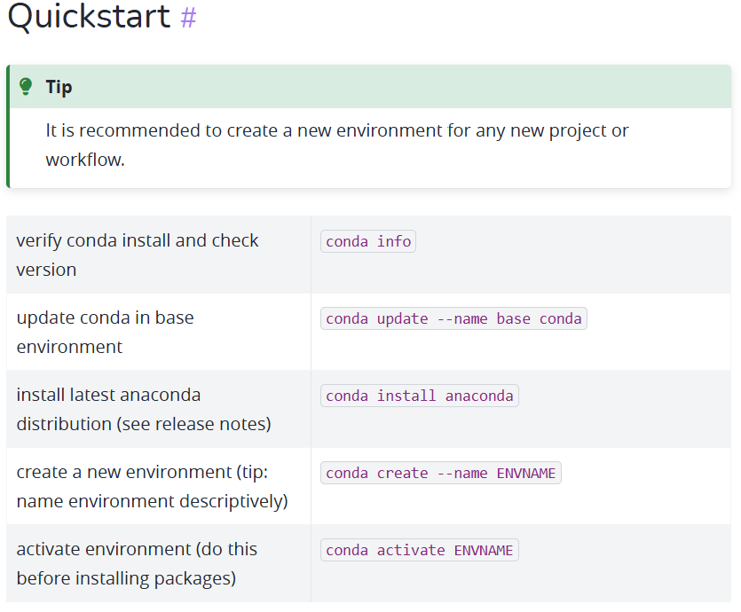

Conda Commands
Conda Cheat Sheet
Notes:
Let’s start with talking about one of the main benefits of using the Anaconda installation of Python. Conda for short comes with its own set of commands to make it simple to manage Python environments, which I sadly had to learn the benefits of the hard way. For details on how to use this see the cheat sheet

Slide 5
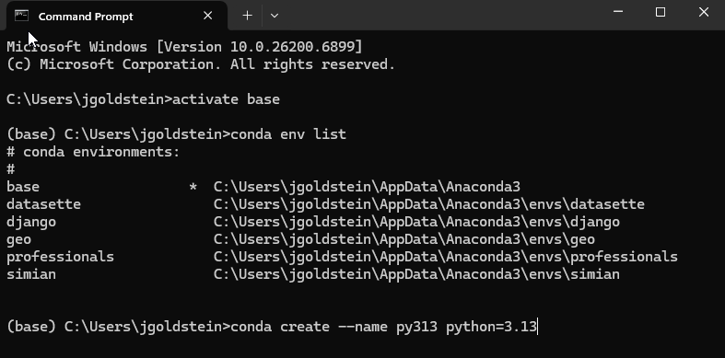
Virtual Environments
Create separate environment for each project or workflow
Test different Python versions without breaking scripts
Prevent conflicting package dependencies
Export list of environment requirements when sharing your code
Notes:
With Python it is highly recommended that practitioners get in the habit of working within virtual environments. These allow you to have siloed instances of Python installed locally, allowing you to have different production and test environments for example, or different versions of Python available simultaneously, not to mention different assortments of installed Python libraries that may not all play nicely with one another. Don’t be like me and learn the hard way when you have to rebuild your system from scratch to keep things running. Environments are very simply to create, you can see the one line there conda create, a name and optionally the version of python you’d like to use if not the most current.

Slide 6
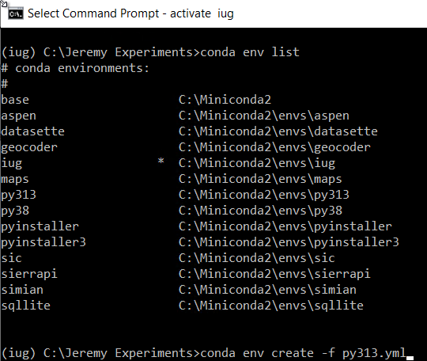

Virtual Environments
Create an environment from an existing .yml file
py313.yml
Notes:
You can also build environment off of a .yml file exported from an existing one, so here’s what we’re using today.
We will be using this py313 environment for all scripts demoed in this workshop, so named because it is running Python 3.13

Slide 7
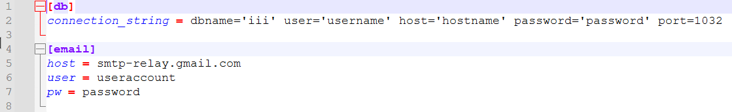
Config File
Key-value pairs organized into sections within a text file
Store your login credentials outside your script
Share your code without sharing your passwords
Reuse across scripts, only need to update in one location
Still a plain txt file holding your passwords so be cautious in how you deploy
Notes:
The next big addition not in the original presentation is the benefit of keeping sensitive information out of your code. An easy method for that is to store that data in an external file such as this config.ini file that will be referenced throughout the scripts in the presentation.

Slide 8
Using a config file
Import configparser
config = configparser.ConfigParser()
config.read("config.ini")
emailhost = config["email"]["host"]
emailuser = config["email"]["user"]
emailpass = config["email"]["pw"]
Notes:
Using a config file in a script is simply if you import the configparser library. With that you can load up an instance of the configparser() function into a variable, read in the config file from wherever it may be stored locally, and then simply refer to the relevant heading and variable name you need to retrieve from your file

Slide 9
Defining Functions
def total_function(parameter1, parameter2):
total = parameter1 + parameter2
return total
def main():
x = 1
y = 2
z = 3
total_1 = total_function(x,y)
total_2 = total_function(y,z)
total_3 = total_function(total_1,total_2)
print(total_3)
main()
Organize code into separate components
Allows portions of code to be reused
Make code modular with portions that can be quickly altered or reused in other coding projects
Parameters can be passed to the functions as variables making them more reusable
Output: 8
Notes:
Now let’s talk functions. These allow us to separate out chunks of our code making them reusable, and greatly helping with organization. Today we’re also aiming to view these as modular features of our scripts, allowing snippets of code to be easily copy and pasted into different projects as needed with minimal additional editing required.
Here you can see how a function works in python, you define it with the def keyword, provide a name and optionally list out any parameters that you might wish to pass to the function. In this example we have a simple function for summing two numbers passed to it as parameter 1 and 2. We also have a main function serving as a wrapper for the body of the code, an approach which can provide some additional benefits as we will see in a bit.

Slide 10
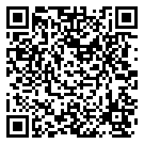
Functions
def main():
query = "WeeklyNewItemsRev.sql"
query_results = run_query(query)
local_file = write_excel(query_results)
send_email(local_file)
main()
weeklynew_2026.py
Notes:
Applying this to Gem’s script we can break the script into three functions, that are then run within a wrapper function called main(). run_query(), write_excel() and send_email() Each of these functions simply pulls out the relevant portion of the original script

Slide 11
Functions
def run_query(query):
# read config file with Sierra login credentials
config = configparser.ConfigParser()
config.read("config.ini")
# Connecting to Sierra PostgreSQL database
try:
conn = psycopg2.connect(config["db"]["connection_string"])
except psycopg2.Error as e:
print("Unable to connect to database: " + str(e))
# Opening a session and querying the database
cursor = conn.cursor()
cursor.execute(open(query, "r").read())
# For now, just storing the data in a variable. We'll use it later.
rows = cursor.fetchall()
conn.close()
return rows
Notes:
for example you can see the run_query() function here. The changes to it are that the query to be used is now specified outside the function as a parameter, so this code can now work with any query at all being passed to it when the function is called, allowing for it to be easily reused in other scripts. And at the end a line is added for return rows, to send the results of the query back to the main function where they are stored in the query_results variable that is created at the same point where the function is called

Slide 12
Inline Query
Use triple quotes for multi-line strings
Full SQL query can be included within the script without requiring external file
def main():
query = ”””
SELECT
distinct 'b'|| rmb.record_num || 'a' AS "Bib Record Num",
----------------------------------------------------------------------------------------------------------------------
WHERE i.record_creation_date_gmt::date>=NOW()::DATE-EXTRACT(DOW FROM
NOW())::INTEGER-10
GROUP BY rmb.record_num, i.location_code, "Call#", brp.best_author, brp.best_title
ORDER BY i.location_code, "Call#", brp.best_author, brp.best_title
”””
query_results = run_query(query)
local_file = write_excel(query_results)
send_email(local_file)
main()
Notes:
In Gem’s script the query being used is stored in an external .sql file that is loaded into the script. But It’s also possible to write it out directly within the Python code as a string variable. Use triple quotes for a multi-line string to make this a lot more readable.
------just truncating the query a bit from the original script

Slide 13
Inline Query
Use triple quotes for multi-line strings
Full SQL query can be included within the script without requiring external file
Now we can use the Python script to make the query more modular as well
Use + to chain strings together
def main(library_code):
query = """
SELECT
distinct 'b'|| rmb.record_num || 'a' AS "Bib Record Num",
--------------------------------------------------------------
WHERE i.record_creation_date_gmt::date>=NOW()::DATE-EXTRACT(DOW FROM
NOW())::INTEGER-10 AND i.location_code = """ + library_code + """
GROUP BY rmb.record_num, i.location_code, "Call#",
brp.best_author, brp.best_title
ORDER BY i.location_code, "Call#", brp.best_author, brp.best_title
"""
query_results = run_query(query)
local_file = write_excel(query_results)
send_email(local_file)
main("adfic")
main("jfic")
Notes:
By taking this approach, our query can be modified within the program itself. In this example A new filter has been added to the where clause of the query to limit results by shelving location, which is being passed to the main function as a parameter. This is one way in which the main() function can be useful as we can pass it different parameters for different results without changing anything else within the script. Now we can cycle through the whole script multiple times, creating individual spreadsheets for different portions of the collection with a very small edit to the script

Slide 14
Inline Query
One additional change required within the run_query function
When executing the query we no longer have to worry about opening and parsing a file
Before
cursor.execute(open(query, "r").read())
After
cursor.execute(query)
Notes:
Using an inline query does require one other small change however to account for the query being contained in a variable within the script instead of an external file that must be read, but that just means simplifying one line of the existing code further.

Slide 15
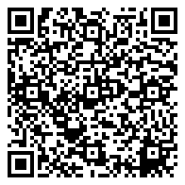
Clean Up and final query
os library for working with the the local operating system
Using remove() function within it to delete the excel file after it’s been successfully emailed
The script has now been reduced to the minimal structure seen here, forming an easy to modify template
import os
def main():
query = """
your query
"""
query_results = run_query(query)
local_file = write_excel(query_results)
send_email(local_file)
os.remove(local_file)
main()
Weeklynew_2026_inline_query.py
Notes:
Very last change to the baseline script we’re working with is to perform some cleanup when the script completes. By calling os.remove we can delete the local copy of our excel file once the email has been sent off and we no longer need it cluttering up our system. And with that we have a fully updated form of the script from Gem’s presentation…and can start using this as a building block for other projects.

Slide 16
Execution Plan
INPUT: Find weekly new titles
Use run_query()
OUTPUT: Generate Excel file of those records
Use write_excel()
DELIVERY: Email file to staff
Use send_email()
Notes:
Here’s how the script was broken out after adapting the code from Gem’s presentation. The plan can be abstracted out to three basic steps, gather some data, build something with it, and put that file somewhere.

Slide 17
Execution Plan
def main():
query = """SELECT * FROM"""
query_results = run_query(query)
local_file=write_excel(query_results)
send_email(local_file)
main()
INPUT: Find weekly new titles
Use run_query()
OUTPUT: Generate Excel file of those records
Use write_excel()
DELIVERY: Email file to staff
Use send_email()
Notes:
This neatly lines up with how we had simplified down the contents of the main function in our final take on Gem’s script.

Slide 18

So Now What?
Input
ILS SQL Query
API call
External Database
Computer Files
Output
Excel
CSV
Google Sheet
Email
API Call
File Delivery
Email
Local File Directory
Cloud Storage
FTP Server
Notes:
With that framework we can now consider swapping out components to fit other needs. Perform different searches, perform different actions with those starting points, these are just a small assortment of the kinds of things we do with this mix and match approach to what I learned from Gem’s presentation and we’ll be exploring for the remainder of this session.

Slide 19
Execution Plan: CSV Files
def main():
query = """SELECT * FROM"""
query_results = run_query(query)
local_file = write_csv(query_results)
send_email(local_file)
main()
INPUT: Find weekly new titles
Use run_query()
OUTPUT: Generate CSV file of those records
New: Use csv for write_csv() function
DELIVERY: Email file to staff
Use send_email()
Notes:
For a starting point let’s look at something simple. That write_excel function is nice but also doesn’t fully fit our plug and play approach given that there’s a lot of project specific customization within the function that’s necessary to match the Excel formatting to the particular data you may be working with. CSV’s’ are far easier to manage. Now all we have to do is swap our new function in for the write_excel function and the rest of the script can remain as as…well other than making sure we include a line for import csv at the start

Slide 20
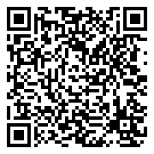
write_csv
csv library lets Python work with csv files
Swap out the write_excel function for the one seen here
Import csv
def write_csv(query_results):
csvfile = "WeeklyNewItem.csv"
with open(csvfile,'w', encoding='utf-8', newline='') as tempFile:
myFile = csv.writer(tempFile, delimiter=',')
myFile.writerows(query_results)
tempFile.close()
return csvfile
weeklynew_2026_csv.py
Notes:
As it turns out the code involved with creating a csv file is pretty straight forward. Create a file name whatever you like. Then open that file in write mode, setting the encoding to utf-8 to play nicely with the Unicode text that came out of Sierra and set the newline parameter to an empty string to cut down on unnecessary line breaks in the resulting file. You can specify any delimiter you like not just commas though that is in fact what I went with in this example, then call writerows to plug in a row of data to the csv for each line of the query results that are being passed into the function. Close the file and return it to make it easily accessible by the main portion of our script.

Slide 21
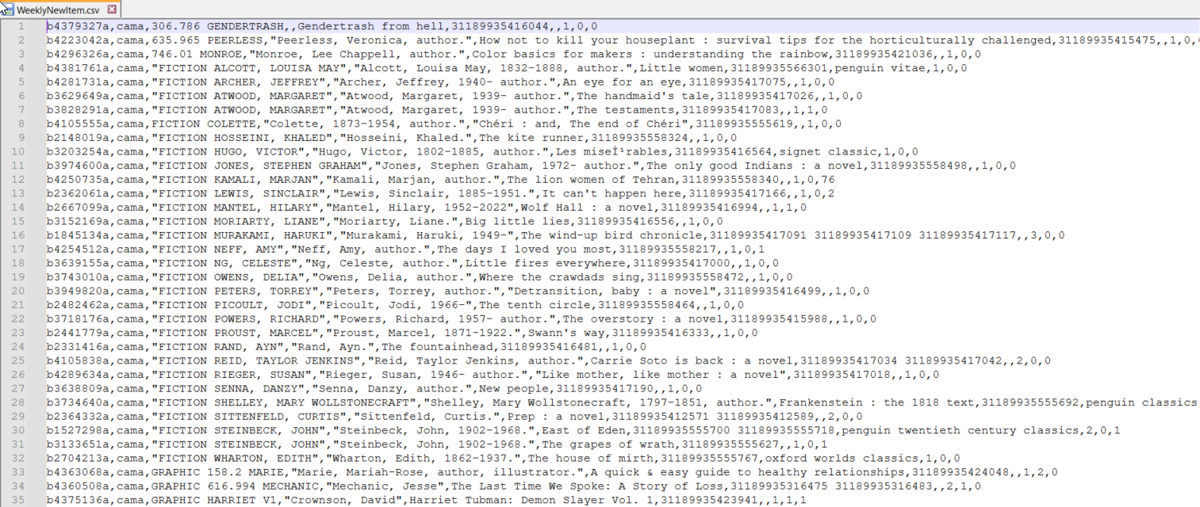
One Problem
Notes:
However, there is one issue. With the write_excel function previously column headers were typed out within the code and we didn’t do that here. We could manually add that in now but we’re aspiring to make these functions more universally reusable so let’s try a different approach.

Slide 22
Correcting For Headers
def run_query(query):
----------------------------------
cursor = conn.cursor()
cursor.execute(query)
rows = cursor.fetchall()
columns = [i[0] for i in cursor.description]
conn.close()
return rows, columns
weeklynew_2026_csv_v2.py
Notes:
I’ve truncated the code here a bit from what we saw in the previous version of our script. It is possible to pull the directly when calling our run_query function with a bit of extra code. We just have to explicitly take row 0 from what’s returned by the query and plug it into it’s own variable, named columns here, and then return that along with the rows. This shows how you still may wish to make some small adjustments to various functions you may wish to repurpose across scripts.

Slide 23
Correcting For Headers
def write_csv(query_results, headers):
csvfile = "WeeklyNewItem.csv"
with open(csvfile,'w', encoding='utf-8', newline='') as tempFile:
myFile = csv.writer(tempFile, delimiter=',')
myFile.writerow(headers)
myFile.writerows(query_results)
tempFile.close()
return csvfile
Def main():
---------
query_results, headers = run_query(query)
local_file = write_csv(query_results, headers)
Notes:
Now it’s just a matter of taking that new variable we’ve created and making sure gets passed back over to the write_csv function where it can be written as an extra row at the start of the file. So when run_query is called in the main function we can populate two different variables in a single line of code, query results and headers.

Slide 24

More Flexible send_email()
def send_email(attachment, subject, message, recipient):
--------------------------------------------------------------
main():
email_subject = "Weekly trending titles"
email_message = """***This is an automated email***
The weekly trending titles report has been attached.
Please take a look and let the Technology Librarian know if there are any questions about it.
"""
emailto = ["jgoldstein@minlib.net"]
send_email(local_file, email_subject, email_message, emailto)
Trending_csv.py
Notes:
Now that you have a rough framework to email out the results of any query you like by simply swapping out the query being used and the rest of the script will continue to function, though you’ll likely want to adjust the email subject line and message to match, not to mention the email recipient(s). In this script I’ve also taken those variables and pulled them out of the send_email() function so that they can be provided to that function as parameters, making the basic script template a bit more flexible still and providing us with an approach for our next script variation. If we didn’t do this, then every time we wanted to automate a new report we’d also have to adjust the send_email function with this information instead of being able to just cut and paste it unedited each time. But there are other benefits as well.

Slide 25
More Flexible send_email()
def send_email(attachment, subject, message, recipient):
--------------------------------------------------------------
main():
email_subject = "Weekly trending titles"
email_message = """***This is an automated email***
The weekly trending titles report has been attached.
Please take a look and let the Technology Librarian know if there are any questions about it.
"""
emailto = ["jgoldstein@minlib.net"]
send_email(local_file, email_subject, email_message, emailto)
Please be sure to update the recipient address!!!
Consider placing it in your config file
Trending_csv.py
Notes:
Just please note if you go and try this yourself later…make sure to put in an address besides mine here. In the code up on the github this is actually pointing to a line that must be filled out in a config file…similar to how we handled Sierra login credentials earlier.

Slide 26
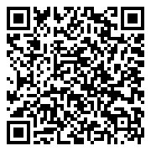
Execution Plan: Renewal Email
INPUT: Find weekly new titles
Use run_query()
OUTPUT: Personalized email text
Adjust email_message variable defined on prior slide
No file generation function needed
DELIVERY: Email file to staff
Use send_email()
NOTE: From here on out examples will involve scripts that are actively in use by Minuteman
Expiring patrons 1.py
Notes:
To see what I mean, let’s look at a quite different application or this sort of script, generating patron notices. For this we’re going to look at an example that we are still using in Minuteman to alert patrons when their cards are about to expire. The input and delivery steps are exactly the same as what we’ve been working with previously, well besides jettisoning the file attachment piece, but for the output we’re purely going to be working with the text within the body of an email and will not be producing a report or file of any sort.

Slide 27
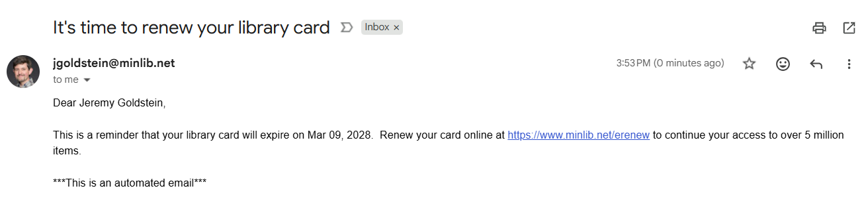
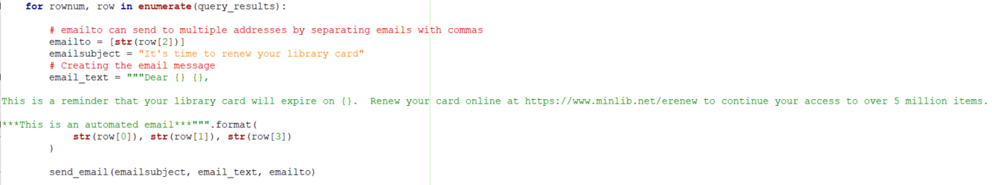
E-mail Mad Libs
Notes:
Instead we have essentially a template that just fills in a few blanks with the data returned by our sql query. Here that’s the email address, the patron’s first and last name and the expiration date. Then you just have to place that within a for loop to generate one email message per user returned by that query.
We run this daily, and have similar emails for patrons whose cards have expired and new patrons. This time out we just eliminate the file attachment, which does also mean streamlining the send_email function a bit to remove any pieces expecting to work with an attachment. And then repeat that for the html version of the email message as well if you’re using that feature.

Slide 28
Expiring Card Query
SELECT
MIN(n.first_name),
MIN(n.last_name),
MIN(v.field_content) as email,
TO_CHAR(p.expiration_date_gmt,'Mon DD, YYYY'),
p.id
FROM sierra_view.patron_record as p
JOIN sierra_view.varfield v
ON p.id = v.record_id AND v.varfield_type_code = 'z'
JOIN sierra_view.patron_record_fullname n
ON p.id = n.patron_record_id
WHERE p.expiration_date_gmt::DATE = (LOCALTIMESTAMP::DATE + INTERVAL '30 days')
GROUP BY 5, 4
Notes:
Here’s the query feeding into this. The MIN() functions are a workaround to get the first listed name and email fields in the record. The way those tables function there is an occurrence number field you can use where the first entry is usually but not always 0…deleting entries can mess with that I think so searching for occ_num = 0 isn’t always reliable.

Slide 29

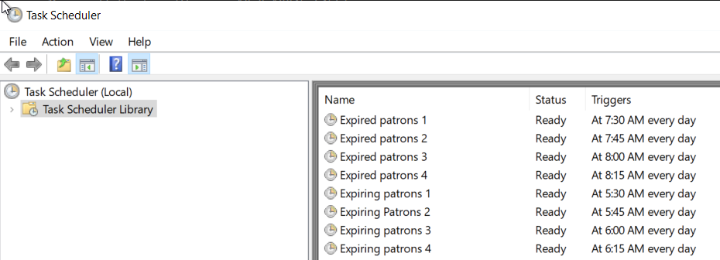
Caveats
Email server may block messages
Sending too many in too short a time likely to trip spam protections
Mitigate that by splitting script into smaller batches of patrons and staggering cron jobs
Notes:
So this method mostly works but is ultimately a bit hacky and prone to somewhat random failures such as the error message seen here when Gmail will sometimes just decide to stop working with the script.
To mitigate that, If you notice the script I linked to at the start of this section was for expiring patrons 1.py. We have 4 copies for each of these sorts of scripts that we run and just add in 1 additional line to the query to filter down results to a subset of patrons for each script. It will still get blocked by the server occasionally, but it’s possibly to set up an alert for when that occurs, we’ll circle back to that at the end.

Slide 30
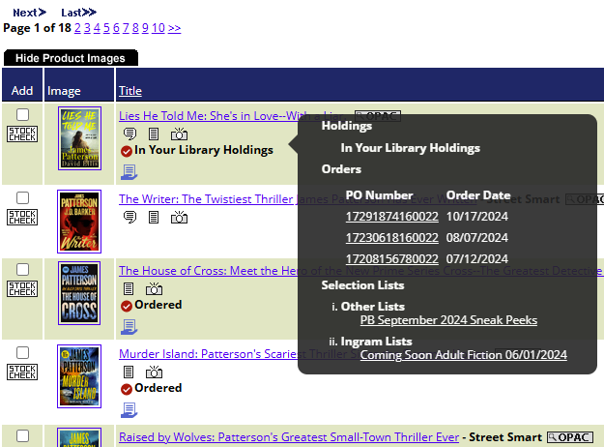
Ingram iHoldings
See in iPage if a title is already in your ILS holdings
Lets you match titles obtained outside of Ingram without needing to check the catalog
Notes:
Now that we’ve stripped this script down to just producing the text of an email…let’s look into some alternate functions entirely that could be introduced without too much effort. This is a somewhat niche example but introduces some potentially interesting options. Ingram’s iholdings feature lets you send your item holdings to them so that duplicate checking can be performed within iPage on those titles.

Slide 31
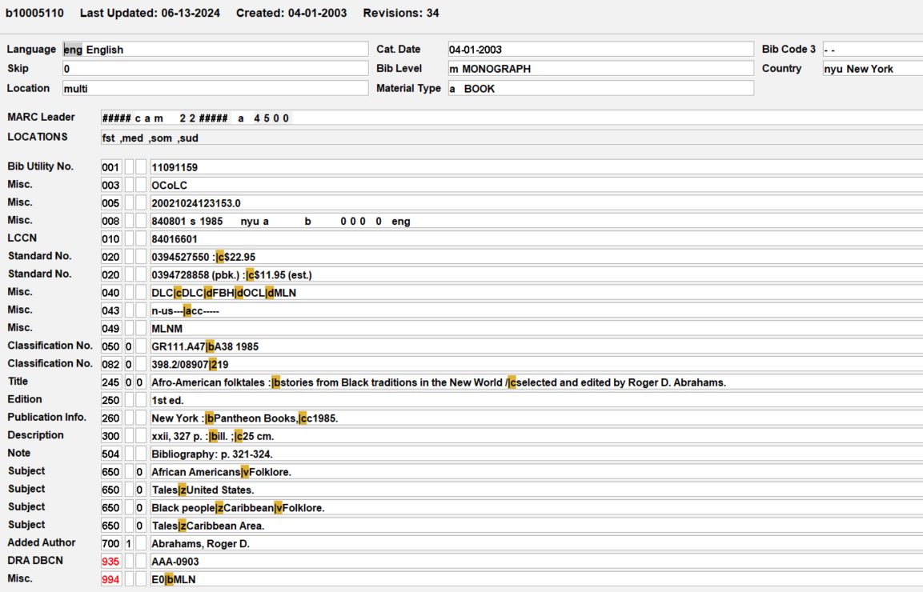
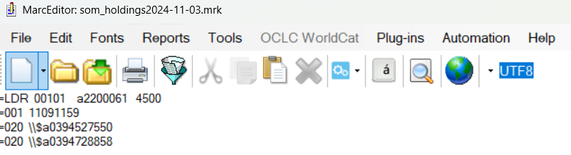
Ingram iHoldings
Requested Data
Necessary Data
Notes:
For this feature Ingram as for MARC record files. At the time we didn’t have scheduler and even if we did we weren’t enthusiastic about messing with our export profile in Sierra. Upon further discussion with Ingram we learned that while they wanted MARC files because of how their system operates, they were in fact only looking at the first ISBN in any given record. So we could reduce full MARC record seen on the left to the bare minimum…actually a little bit more than that even since Ingram didn’t actually ask us to include a record identifier in the 001 as we opted to do here...it just seemed like it might be useful to have a unique id per record. Again this is a bit of a silly example but helps to illustrate the difference between what is often requested and what is strictly necessary. Just consider if this were a vendor requesting patron data instead of a bib record.

Slide 32
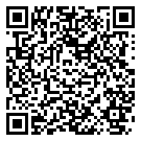
Execution Plan: iHoldings
INPUT: Find bib records to include in holdings
Use run_query()
Note: Separate query for each library as they may each wish to use different filters for the holdings they provide
OUTPUT: Generate MARC file of those records
New: Use pymarc for marc_writer() function
DELIVERY: FTP MARC file to Ingram
New: Use pysftp for sftp_file() function
Ingram Holdings
Notes:
So mapping out the execution plan on this, we’re running the query mostly as normal though we have structured this so that we could use potentially vastly different queries for each library. The output in this case is a MARC file, using the pymarc library for python. And then we’re going to take those files and ftp them to Ingram using the pysftp libray

Slide 33


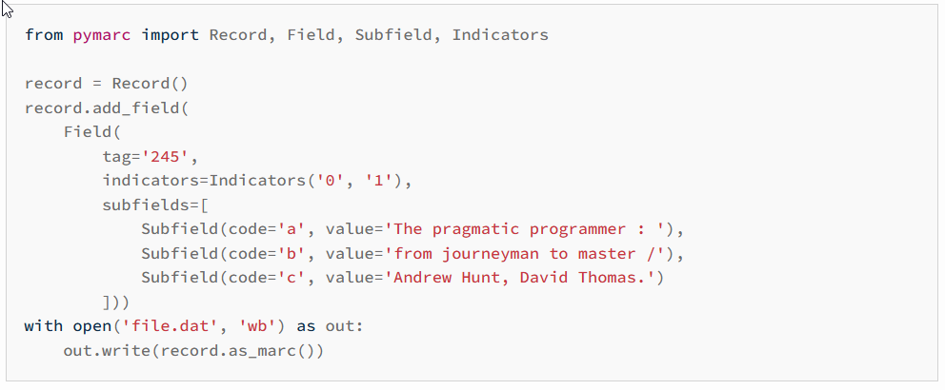
Pymarc
Pymarc on Gitlab
Pymarc Documentation
Notes:
So this is Pymarc, which allows you to read and write marc files via Python. For more information check out the project on gitlab or their complete documentation, but what you see here may give you a broad sense of how you can use the library to construct a bib record. Use the record() function to generate a blank record, append fields, subfields, indicators to it as needed and then write the completed records out to a file.

Slide 34
marc_writer()
Import pymarc
def marc_writer(query_data, marc_file):
os.makedirs(os.path.dirname(marc_file), exist_ok=True)
with open(marc_file, "wb") as f:
#loop through each row of the file
for rownum, row in enumerate(query_data):
#declare PyMARC record object
item_load = pymarc.Record(to_unicode=True, force_utf8=True)
#define data fields in CSV file
ocn = row[1]
isbn = row[2].split('|')
#write data to field variables
field_001 = pymarc.Field(tag='001', data=ocn)
item_load.add_ordered_field(field_001)
for i in isbn:
if i == '':
break
field_020 = pymarc.Field(
tag='020',
indicators = pymarc.Indicators(' ',' '),
subfields = [pymarc.Subfield(code='a', value=i)]
)
item_load.add_ordered_field(field_020)
#write data to file
f.write(item_load.as_marc())
return marc_file
Notes:
So here is how you too can build the world’s worst MARC records. We’re pulling out the 001 and any 020 fields retrieved via a sql query, generating fields based on those, in the case of the 020’s producing one for each isbn, which the query aggregates into a single delimited field, hence the split on pipes seen at the bottom there, and writes the resulting records to a marc file.

Slide 35
sftp_file()
#open sftp connection
srv = pysftp.Connection(
host=config["ingram"]["host"],
username=config["ingram"]["user_" +
library],
password=config["ingram"]["pw_" +
library],
cnopts=cnopts,
)
#upload specified file to root directory
srv.put(file)
#close connection
srv.close()
from import pysftp
def sftp_file(file, library):
# read config file with Sierra login
credentials
config = configparser.ConfigParser()
config.read("config.ini")
# set connection option to disable check
for host key
cnopts = pysftp.CnOpts()
cnopts.hostkeys = None
Notes:
This is passed the marc file we just created and simply opens a connection to an FTP server Ingram setup (host and credentials in our config.ini file again), copies the file and then closes the connection.
Using the config file once again for Ingram’s credentials, with different but consistent entries for each of the libraries we have to log into an account for. The function is passed the code we associate with each library, which we then append to the name of the user and pw keys in the .ini files.

Slide 36
Ingram_iholdings main()
def main(library):
#run holdings query for specified library
query = open(library + "_ingram_holdings.sql",
"r").read()
query_results = run_query(query)
#generate marc file from those query results
marc_file_name = (
"/Scripts/Ingram Holdings/Temp_Files/"
+ library
+ "_holdings{}.mrc".format(date.today())
)
marc_file = marc_writer(query_results,
marc_file_name)
# sftp file to Ingram
sftp_file(
"C:\\Scripts\\Ingram Holdings
\\Temp_Files\\"
+ library +
"_holdings{}.mrc".format(
date.today()
), library)
# delete file when done
os.remove(marc_file)
main("blm")
main("con")
Notes:
For this script I’ve gone back to pointing to external query files instead of including the sql directly within the script. That’s so I can do a similar trick to the ftp passwords in the prior slide with the queries I’m going to run and tell the script for each running of the main function to use the query that includes a particular library’s code within the name. And then that gets used yet again to name the .mrc files that are being created.
When using the pysftp library the put command that uploads the file requires a full path to the file being uploaded so that clutters up the code a bit more than we’ve seen elsewhere.

Slide 37
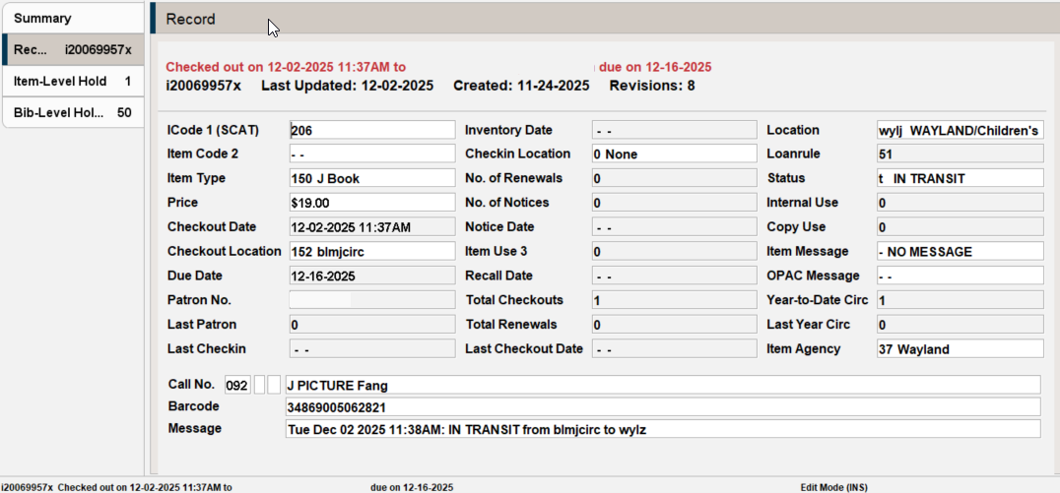
Correct Checkin Errors
Notes:
For our final script, which will introduce the Sierra API into this mix we’re going to look at a recent special project of mine. This past year I got really invested in identifying instances of this behavior in Sierra where an item appears to be simultaneously checked out and in transit. This typically happens when a patron checks out at one station, and with their account left open turns around and has the item checked back in at a different station. The checkin is attempted while the checkout hasn’t been finalized, and once the account is closed out on the checkout terminal you wind up with this mess. Note the timestamp in the transit message, representing the checkin time, is a minute after the checkout time. Checking the item in again fixes things, but I wanted to work on addressing these proactively in order to get items off of patron accounts without needing to wait for deliveries to go through.

Slide 38
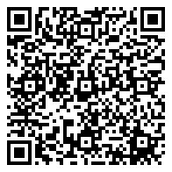
Execution Plan: Fix Checkin Errors
INPUT: Find items that are simultaneously in transit and checked out
Use run_query()
(Optional) OUTPUT: Append query results to Google Sheet
New: Use pygsheets for appendToSheet() function
Must enable Google API access and create a json credentials file
See https://docs.gspread.org/en/latest/oauth2.html
DELIVERY: Checkin item with SierraAPI to fix error
New: Use sierra_ils_utils for checkin_item() function
Correct Checkin Errors.py
Notes:
Here’s the plan this time out. Identify these errors via a sql query, in our case log them to the Google sheet shared among a few consortia staff members so we can track how widespread a problem this is, and then check the items back in with the Sierra API

Slide 39
The Query
SELECT
ip.barcode, u.name AS username,
u.statistic_group_code_num AS checkin_stat_group_code,
TO_TIMESTAMP(SPLIT_PART(v.field_content,': IN',1),
'Dy Mon DD YYYY HH:MIAM')::VARCHAR AS checkin_time,
so.name AS checkout_stat_group_name,
i.checkout_statistic_group_code_num AS checkout_stat_group_code,
o.checkout_gmt::VARCHAR AS checkout_time,
v.field_content AS message,
SPLIT_PART(SPLIT_PART(v.field_content,'from ',2),' to',1) AS origin_loc,
SPLIT_PART(v.field_content,'to ',2) AS destination_loc,
CASE
WHEN h.id IS NOT NULL THEN TRUE ELSE FALSE
END AS fulfilling_hold
Notes:
A lot of the work in this query is just taking the in transit message and parsing it out into individual components. The username associated with the checkin is included, so you can pull that out, join it to the iii_user table and then pull what checkin stat group ought to have been recorded from there. For the api call we’ll be making we only need three fields in fact, barcode, username and that stat group number. The rest of the information being pulled out in this query, such as flagging where the items are going and whether the items are in transit to fulfill a hold or just being returned to their owning location is for the sake of the log we’re keep to get a sense of the full extent of these occurrences.

Slide 40
The Query Cont.
FROM sierra_view.item_record i
JOIN sierra_view.checkout o ON i.id = o.item_record_id
JOIN sierra_view.varfield v ON i.id = v.record_id
AND v.varfield_type_code = 'm' AND v.field_content LIKE '%IN TRANSIT%'
JOIN sierra_view.item_record_property ip ON i.id = ip.item_record_id
JOIN sierra_view.statistic_group_myuser so
ON i.checkout_statistic_group_code_num = so.code
JOIN sierra_view.iii_user u ON SPLIT_PART(SPLIT_PART(v.field_content,'from ',2),
'to',1) = u.name
LEFT JOIN sierra_view.hold h ON i.id = h.record_id
WHERE i.item_status_code IN ('t') AND EXTRACT(EPOCH FROM (CURRENT_TIMESTAMP –
TO_TIMESTAMP(SPLIT_PART(v.field_content,': IN',1),'Dy Mon DD YYYY HH:MIAM')))>120
ORDER BY TO_TIMESTAMP(SPLIT_PART(v.field_content,': IN',1),'Dy Mon DD YYYY HH:MIAM')
Notes:
The rest of the query is mostly just joining tables together. The one gotcha we discovered after running this for a bit is that occasionally it could catch a checkin as it was actively happening in the moment between the checkin information being written to the item and the checkout being cleared. To avoid that we added a short delay in the where clause, looking for items that were checked in at least a few minute ago.

Slide 41
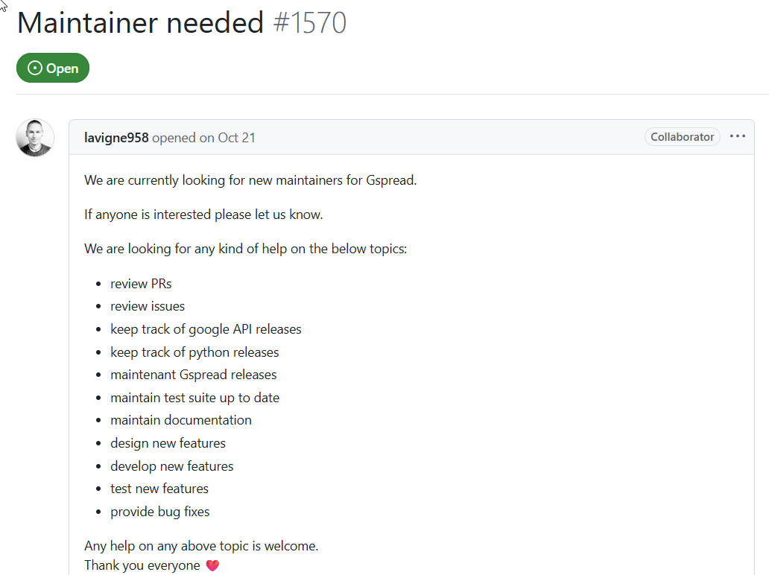
Open Source Probelms
https://github.com/burnash/gspread/issues/1570
Notes:
Now moving on to the Google sheet portion of this script. In the course of putting this presentation together I discovered this issue posted to the github for the Gspread library I had been using for years to edit Google Sheets via Python. This led me to wanting to find an alternative and recode a whole bunch of scripts, including this one on short notice. Incidentally this was posted in October and it was only about 3 weeks ago that anyone else stepped up to potentially volunteer so we’ll see maybe it can live on after all…but I’ve already moved on.

Slide 42
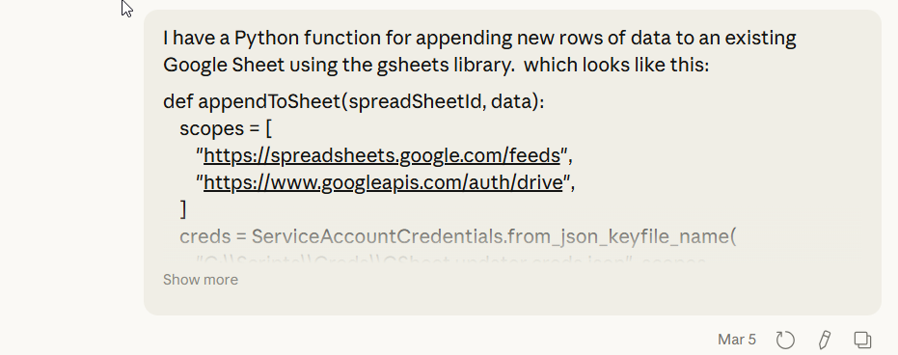
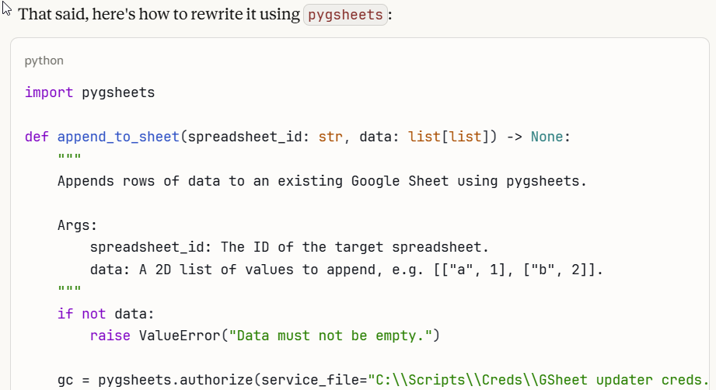
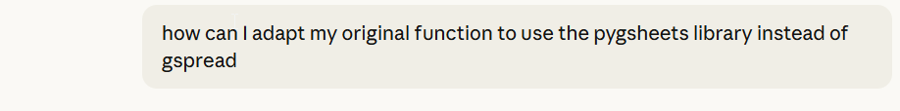
Vibe Coding
Anthropic (2026). ClaudeAI (March 5 version)
https://claude.ai/chat/
Notes:
That said I was in a hurry to make this work for a number of live scripts that I needed to maintain so I resorted to some vibe coding to get by. Essentially providing a sample of the append_to_sheet function I had been using with gspread and prompting for a way to adopt it to using the pygsheets library instead. Pygheets is essentially a wrapper for working with Google’s APIS and this worked fairly well for me.

Slide 43
appendToSheet()
import pygsheets
def appendToSheet(spreadSheetId, data):
#use conditional logic to prevent errors from function being passed an empty dataset
if not data:
gc = pygsheets.authorize(service_file="GSheet updater creds.json")
sh = gc.open_by_key(spreadSheetId)
wks = sh.sheet1 # or sh.worksheet_by_title("My Sheet")
# Find the first empty row and insert data there
first_empty_row = len(wks.get_all_values(include_tailing_empty_rows=False)) + 1
rows_needed = first_empty_row + len(data) - 1
# Expand the sheet if the data would exceed the current grid size
if rows_needed > wks.rows:
wks.add_rows(rows_needed - wks.rows)
wks.update_values(f"A{first_empty_row}", data)
Notes:
Here we’ve got my version of Claude’s response with some slight changes, names before it had the script produce a full error statement if the function was passed a blank dataset and I changed that to simply skipping the function entirely when the data is blank. The function itself is fairly straightforward. Authenticate with Google (more on that next slide), open a given spreadsheet, find the first empty row to begin appending data, if the sheet is full, add enough new rows to match our dataset, and then pass that all in.

Slide 44
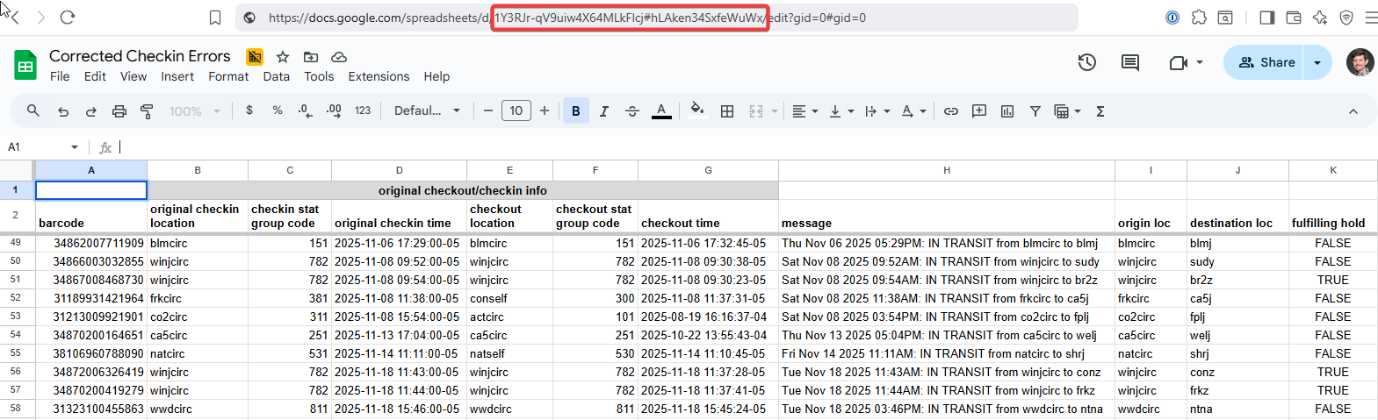
Google Sheets and gspread
Pygsheets authentication requirements
Follow pygsheets instructions to enable API access Generate JSON credentials file and save that locally where the script may reference it
Share spreadsheet with client_email listed in that file and grant it editing permissions
Note the Sheet ID found within the URL
https://pygsheets.readthedocs.io/en/stable/authorization.html
Notes:
For the Google authentication piece this is a pain to set up initially and I’m only glossing over it here, but then once you’ve done it once you can reuse the credentials file for updating other spreadsheets as well, if this is something you might wish to take further advantage of. In Minuteman we have a number of data visualization dashboards, things like charts of daily checkouts, that work off of spreadsheets like this…we just append daily totals using this method. So it can be well worth stumbling through the initial setup. Fortunately the guidance pygsheets provides is quite helpful…Google’s on the other hand leaves a LOT to be desired.

Slide 45
parse_pg_data()
import datetime
# converts psycopg2 fetchall() output to matrix required by pygsheets
def parse_pg_data(rows):
def convert(val):
if val is None:
return ""
if isinstance(val, (datetime.date, datetime.datetime)):
return val.isoformat() # e.g. "2026-03-04"
return val # int, float, str pass through as-is
return [list(convert(val) for val in row) for row in rows]
Notes:
In testing there was one more gotcha however, which required the creation of an additional function also largely vibe coded by Claude. Pygsheets has some requirements for the exact formatting it expect data to be in, which doesn’t match the default output coming out of our postgresql query. This simply modifies our existing data to match those requirements.

Slide 46


Sierra API and sierra-ils-utils
Using sierra-ils-utils library developed by Ray Voelker
Wrapper for HTTPX library, designed for making the Sierra RestAPIs easier to use
Will need to obtain a key with the Items Write Role
Enter API information into config.ini file
Notes:
Now we’re ready to tackle the Sierra API and for this we’re going to be utilize a library developed by IUG’s own Ray Voelker. Just as pygsheets was a wrapper for the Google Sheets API, sierra-ils-utils is that for Sierra’s. You will need an API key for yourself with the item write role to make this work…once you have that, you can just add more to that config file, which sure is a scary text file with a lot of passwords at this point, so be cautious with that.

Slide 47
init_api()
from sierra_ils_utils import SierraAPI
def init_api():
config = configparser.ConfigParser()
config.read("config.ini")
base_url = config["api"]["base_url"]
client_key = config["api"]["client_key"]
client_secret = config["api"]["client_secret"]
# launch SierraAPI session
sierra_api = SierraAPI(base_url, client_key, client_secret)
sierra_api.request("GET", "info/token")
return sierra_api
Correct Checkin Errors.py
Notes:
Now we’re actually creating two different functions to use the API, This one initialize the API for the entire time the script runs, so will be called once while the checkin piece will get called once for every error our query reports out. With sierra-ils-utils initializing is simple, send the combined url, key and secret to the get info/token endpoint and that will return an object containing the access token you will be using for all additional API calls.

Slide 48
Checkin_item()
def checkin_item(barcode, username, statgroup, sierra_api):
url = ("items/checkouts/" + barcode + "?username=" + username +
"&statgroup=" + statgroup)
request = sierra_api.request("DELETE", url)
request.raise_for_status()
main():
# launch SierraAPI session
sierra_api = init_api()
# for each item in the error_query results, check it in again
for rownum, row in enumerate(item_errors):
checkin_item(str(row[0]), row[1], str(row[2]), sierra_api)
Notes:
The function will accept the three field we discussed when looking at the query earlier, as well as a parameter for an api session we’ll launch within the main() function.
Then you simply plug those three fields into the blanks within the url used for calling the items/checkouts delete endpoint (fun fact a checkin is handled as deleting an entry in the checkout table) and execute the request specifying that it’s a delete action, that’s it.

Slide 49
Final Script
from sierra_ils_utils import SierraAPI
import json
import configparser
import psycopg2
import os
Import datetime
import pygsheets
Def init_api():
#see slide 46
def runquery(query):
#see slide 11
def checkin_item(barcode,username,statgroup,sierra_api)
#see slide 47
def appendToSheet(spreadSheetId, data)
#see slide 42
def parse_pg_data(rows)
#see slide 44
def main():
error_query = # see slides 38-39
item_errors = runquery(error_query)
# log query results to preexisting Google sheet
config = configparser.ConfigParser()
config.read("config.ini")
item_errors_parsed = parse_pg_data(item_errors)
appendToSheet(config["gsheet"]["correct_checkins"], item_errors_parsed)
# initialize Sierra API
sierra_api = init_api()
# check in each item in item_errors
for rownum, row in enumerate(item_errors):
checkin_item(str(row[0]), row[1], str(row[2]),
sierra_api)
main()
Notes:
The final script breaks down like this, filling in the code from the past few slides where noted, just removed here in the interest of fitting this all on a single slide. The script in the repo has everything written out correctly. Note using a for loop to repeatedly call the checkin_item function as many times as needed.

Slide 50
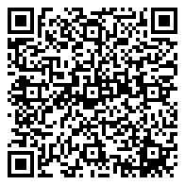
Final Script...Really
import traceback
# run main function and send error email to admin if script encounters an error
if __name__ == "__main__":
try:
main()
except Exception:
# read config file with recipient list for email
config_recipient = configparser.ConfigParser()
config_recipient.read("emails.ini")
emailto = config_recipient["script_error"]["recipients"].split()
# craft email subject and message containing error message details from traceback
email_subject = "correct checkin errors script error"
email_message = "Your script failed with the following error:\n\n" + traceback.format_exc()
send_email_error(email_subject, email_message, emailto)
raise
Correct Checkin Errors_v2.py
Notes:
Okay I lied I have one last thing to leave you with today. Remember a while back during the email mad libs bit where I mentioned generating error notices. This is that piece. So after completing most of this presentation, I started adding a significant addition to all our automated scripts. So my apologies that this logic isn’t properly referenced throughout the presentation, but you will see this in my current example if you link out to my github. What you see here is the result of some minor vibe coding. I wanted an email alert to be generated if a script encounters an error during execution. By wrapping the main() function within a try/except block you can test for errors, if there are none the code runs, if there are it instead calls the new send_email_error function…which is pretty much identical to the send_email function seen already, but I made it its own function so I could easily just copy and paste this new element into existing scripts with little effort. Note the emails.ini file, we use that ini file to store recipients for any scripts we that send out emails to staff.

Slide 51

Thank You!
Jeremy Goldstein
Minuteman Library Network
jgoldstein@minlib.net
https://github.com/jmgold/IUG2026--Automating-Reports-with-Python-2
https://github.com/Minuteman-Library-Network/Scripts
This Presentation
Active Minuteman Scripts

